Slide 1

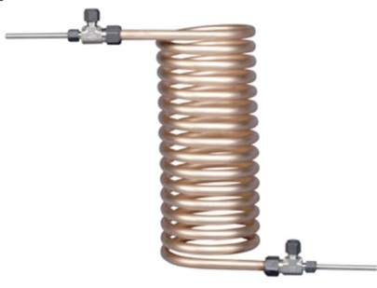
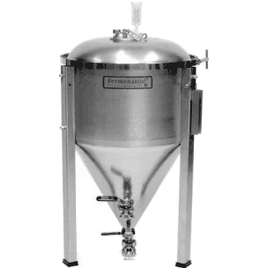
Based on MyHerms
HLT
MLT
BK
false bottom
9
10
4
burner
burner
H2O
IN
1
3
P2
2
7
5
6
8
P1
H2O
OUT
Phase 1: filling HLT w/ cold H2O
fermenter

Slide 2
Based on MyHerms
HLT
MLT
BK
false bottom
9
10
4
burner
burner
H2O
IN
1
3
P2
2
7
5
6
8
P1
H2O
OUT
Phase 2: heating and recirculating H2O in HLT
fermenter

Slide 3
Based on MyHerms
HLT
MLT
BK
false bottom
9
10
4
burner
burner
H2O
IN
1
3
P2
2
7
5
6
8
P1
H2O
OUT
Phase 3: filling MLT w/ heated H2O
fermenter

Slide 4
Based on MyHerms
HLT
MLT
BK
false bottom
9
10
4
burner
burner
H2O
IN
1
3
P2
2
7
5
6
8
P1
H2O
OUT
Phase 4: refilling HLT w/ H2O (as needed)
fermenter

Slide 5
Based on MyHerms
HLT
MLT
BK
false bottom
9
10
4
burner
burner
H2O
IN
1
3
P2
2
7
5
6
8
P1
H2O
OUT
Phase 5: heating and recirculating HLT/MLT
fermenter

Slide 6
Based on MyHerms
HLT
MLT
BK
ADD GRAINS
false bottom
9
10
4
burner
burner
H2O
IN
1
3
P2
2
7
5
6
8
P1
H2O
OUT
Phase 6: recirculating wort in heated HLT
fermenter

Slide 7
Based on MyHerms
HLT
MLT
BK
false bottom
9
10
4
burner
burner
H2O
IN
1
3
P2
2
7
5
6
8
P1
H2O
OUT
Phase 7a: sparge out wort to BK (batch sparge)
fermenter

Slide 8
Based on MyHerms
HLT
MLT
BK
false bottom
9
10
4
burner
burner
H2O
IN
1
3
P2
2
7
5
6
8
P1
H2O
OUT
Phase 7b: sparge out H2O to MLT (batch sparge)
fermenter

Slide 9
Based on MyHerms
HLT
MLT
BK
false bottom
9
10
4
burner
burner
H2O
IN
1
3
P2
2
7
5
6
8
P1
H2O
OUT
Phase 7c: sparge out wort to BK (batch sparge)
fermenter

Slide 10
Based on MyHerms
HLT
MLT
BK
false bottom
9
10
4
burner
burner
H2O
IN
1
3
P2
2
7
5
6
8
P1
H2O
OUT
Phase 7’: fly sparge HLT to MLT to BK
fermenter

Slide 11
Based on MyHerms
HLT
MLT
BK
ADD HOPS
false bottom
9
10
4
burner
burner
H2O
IN
1
3
P2
2
7
5
6
8
P1
H2O
OUT
Phase 8: boiling wort
fermenter

Slide 12
Based on MyHerms
HLT
MLT
BK
false bottom
9
10
4
burner
burner
H2O
IN
1
3
P2
2
7
5
6
8
P1
H2O
OUT
Phase 9: cooling wort and filling fermenter
fermenter

Slide 13
Based on MyHerms
HLT
MLT
BK
false bottom
9
10
4
burner
burner
H2O
IN
1
3
P2
2
7
5
6
DRAIN
8
P1
H2O
OUT
Phase 10a: filling HLT

Slide 14
Based on MyHerms
HLT
MLT
BK
false bottom
9
10
4
burner
burner
H2O
IN
1
3
P2
2
7
5
6
DRAIN
8
P1
H2O
OUT
Phase 10b: filling MLT

Slide 15
Based on MyHerms
HLT
MLT
BK
false bottom
9
10
4
burner
burner
H2O
IN
1
3
P2
2
7
5
6
DRAIN
8
P1
H2O
OUT
Phase 10c: cycling MLT water

Slide 16
Based on MyHerms
HLT
MLT
BK
false bottom
9
10
4
burner
burner
H2O
IN
1
3
P2
2
7
5
6
DRAIN
8
P1
H2O
OUT
Phase 10d: draining MLT

Slide 17
Based on MyHerms
HLT
MLT
BK
false bottom
9
10
4
burner
burner
H2O
IN
1
3
P2
2
7
5
6
DRAIN
8
P1
H2O
OUT
Phase 10e: filling HLT

Slide 18
Based on MyHerms
HLT
MLT
BK
false bottom
9
10
4
burner
burner
H2O
IN
1
3
P2
2
7
5
6
DRAIN
8
P1
H2O
OUT
Phase 10f: filling MLT

Slide 19
Based on MyHerms
HLT
MLT
BK
false bottom
9
10
4
burner
burner
H2O
IN
1
3
P2
2
7
5
6
DRAIN
8
P1
H2O
OUT
Phase 10g: filling BLK

Slide 20
Based on MyHerms
HLT
MLT
BK
false bottom
9
10
4
burner
burner
H2O
IN
1
3
P2
2
7
5
6
DRAIN
8
P1
H2O
OUT
Phase 10h: draining BLK

Slide 21
Based on MyHerms
HLT
MLT
BK
false bottom
9
10
4
burner
burner
H2O
IN
1
3
P2
2
7
5
6
8
P1
H2O
OUT
fermenter

